Slide 1


Locarno silvia
Minotti luca
Bespoke jewelry
20th july 2021

Slide 2

Jewelly is a manufacturing company that produces bespoke jewelry.
Starting from the design of the jewel that the customer wants, our company is able to produce it and deliver it directly to his home.
OUR COMPANY
SERVICE DESCRIPTION

Slide 3






CUSTOMER
An overview
BANK
JEWELLY
SUPPLIER PARTNER
DELIVERY PARTNER

Slide 4
Archimate Modeling
Business Process Choreography
Business Process Orchestration
Soundness Checks
Design and implementation of 3rd-party APIs
Executable Process
What we have done

Slide 5
Archimate is a language for enterprise architecture modelling to support the description analysis and visualization of the architecture within and across business domain.
The goal of the Archimate model is to define the process at high level of granularity, how the consumer is connected to the enterprise and how the processes are related
Archimate Model

Slide 6
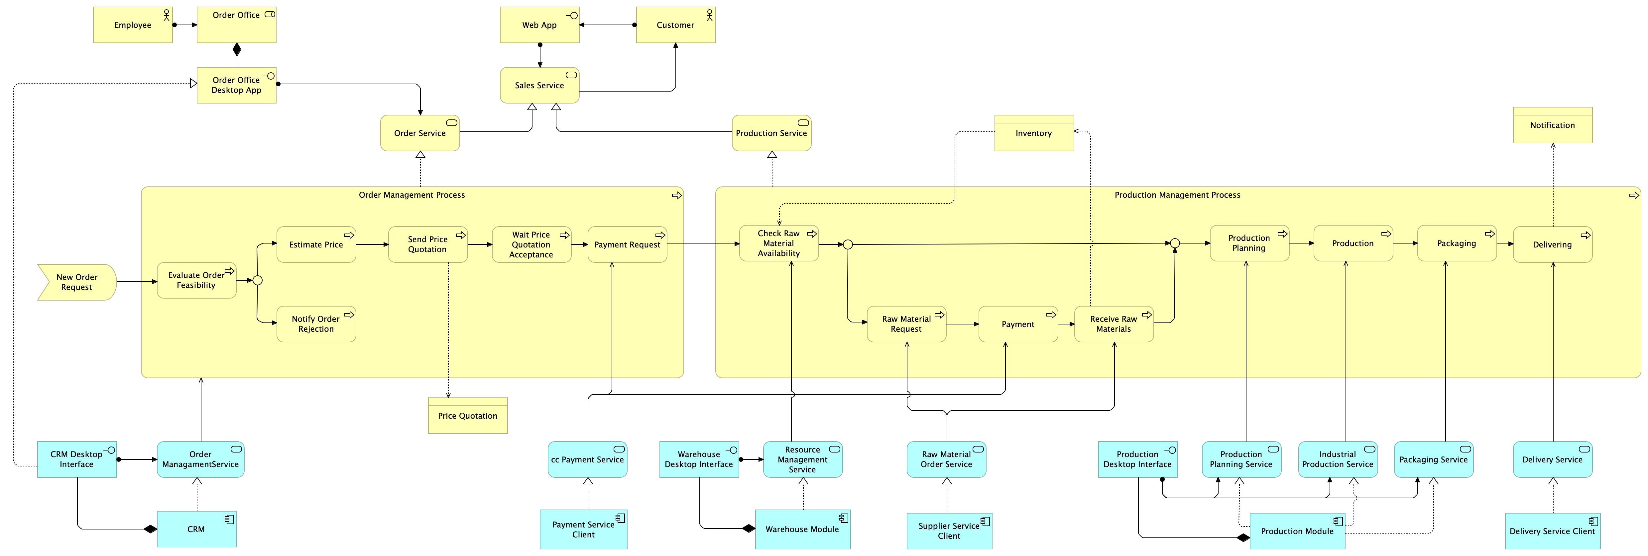
ARCHIMATE MODEL
Part 1
Our model consists of two major processes:
Order Management: realizes the order service
Production Management: realizes the production service
The two services contribute to the realization of the sales service, which is the main service of Jewelly.

Slide 7
ARCHIMATE MODEL
Part 1I

Slide 8
ARCHIMATE MODEL
FULL VIEW

Slide 9
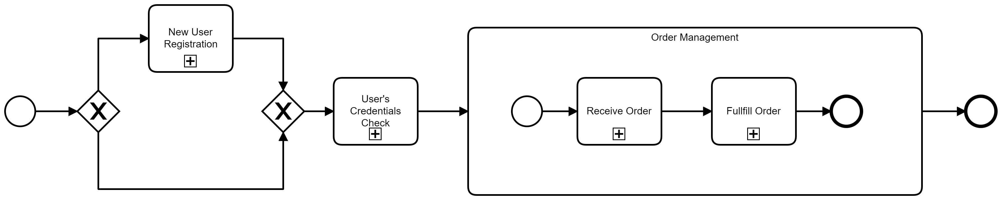
The main subprocesses of our organization:
User registration
User login
HIGH-LEVEL ORCHESTRATION
Receive order
Fulfil order

Slide 10
The choreography diagram provides a high-level perspective focused only on the relationships among the organization, but without specifying the internal processes.
It does not take the standpoint of any of the participants and typically is the base from which the collaboration diagram is derived.
Choreography

Slide 11
CHOREOGRAPHY
USER REGISTrAtioN
The interaction begins with the receipt of the registration data from the customer. If the data are correct then an email to confirm the registration is sent to the customer. The confirmation email contains a link that must be clicked by the user within one hour to complete the registration. Following this, Jewelly sends a registration confirmation email and a welcome email.

Slide 12
CHOREOGRAPHY
USER LOGIN
The interaction begins with the receipt of the login data from the user.
The outcome of the data verification is then sent to the customer.

Slide 13
CHOREOGRAPHY
RECEIVE ORDER
The interaction begins with the receipt of the order data. Then follows the sending of the price quotation to the customer. At this point, Jewelly waits for the acceptance of the price quotation for a week. Once received, the payment process takes place through the exchange of messages between the company and the 3rd-party and between the 3rd-party and the user.

Slide 14
CHOREOGRAPHY
FULFILL ORDER
PART I
The beginning of the process follows the payment of the order by the customer.
If necessary, a price quotation request is sent to multiple suppliers for the order of materials. After the choice of the most convenient supplier, the order is emitted.
Then follows the actual payment.

Slide 15
CHOREOGRAPHY
FULFILL ORDER
PART Ii

Slide 16
CHOREOGRAPHY
FULFILL ORDER
PART iIi
The payment to the delivery partner takes place every month and, also in this case, it is managed by the payment 3rd-party.

Slide 17
Orchestration concerns the management of activities executed under a common controlling element (the orchestrator). Usually, the boundary of an orchestrator is an organization.
The orchestrator controls the execution of the business process according to a control-flow model. The control-flow is usually modelled based on a set of patterns.
Orchestration

Slide 18
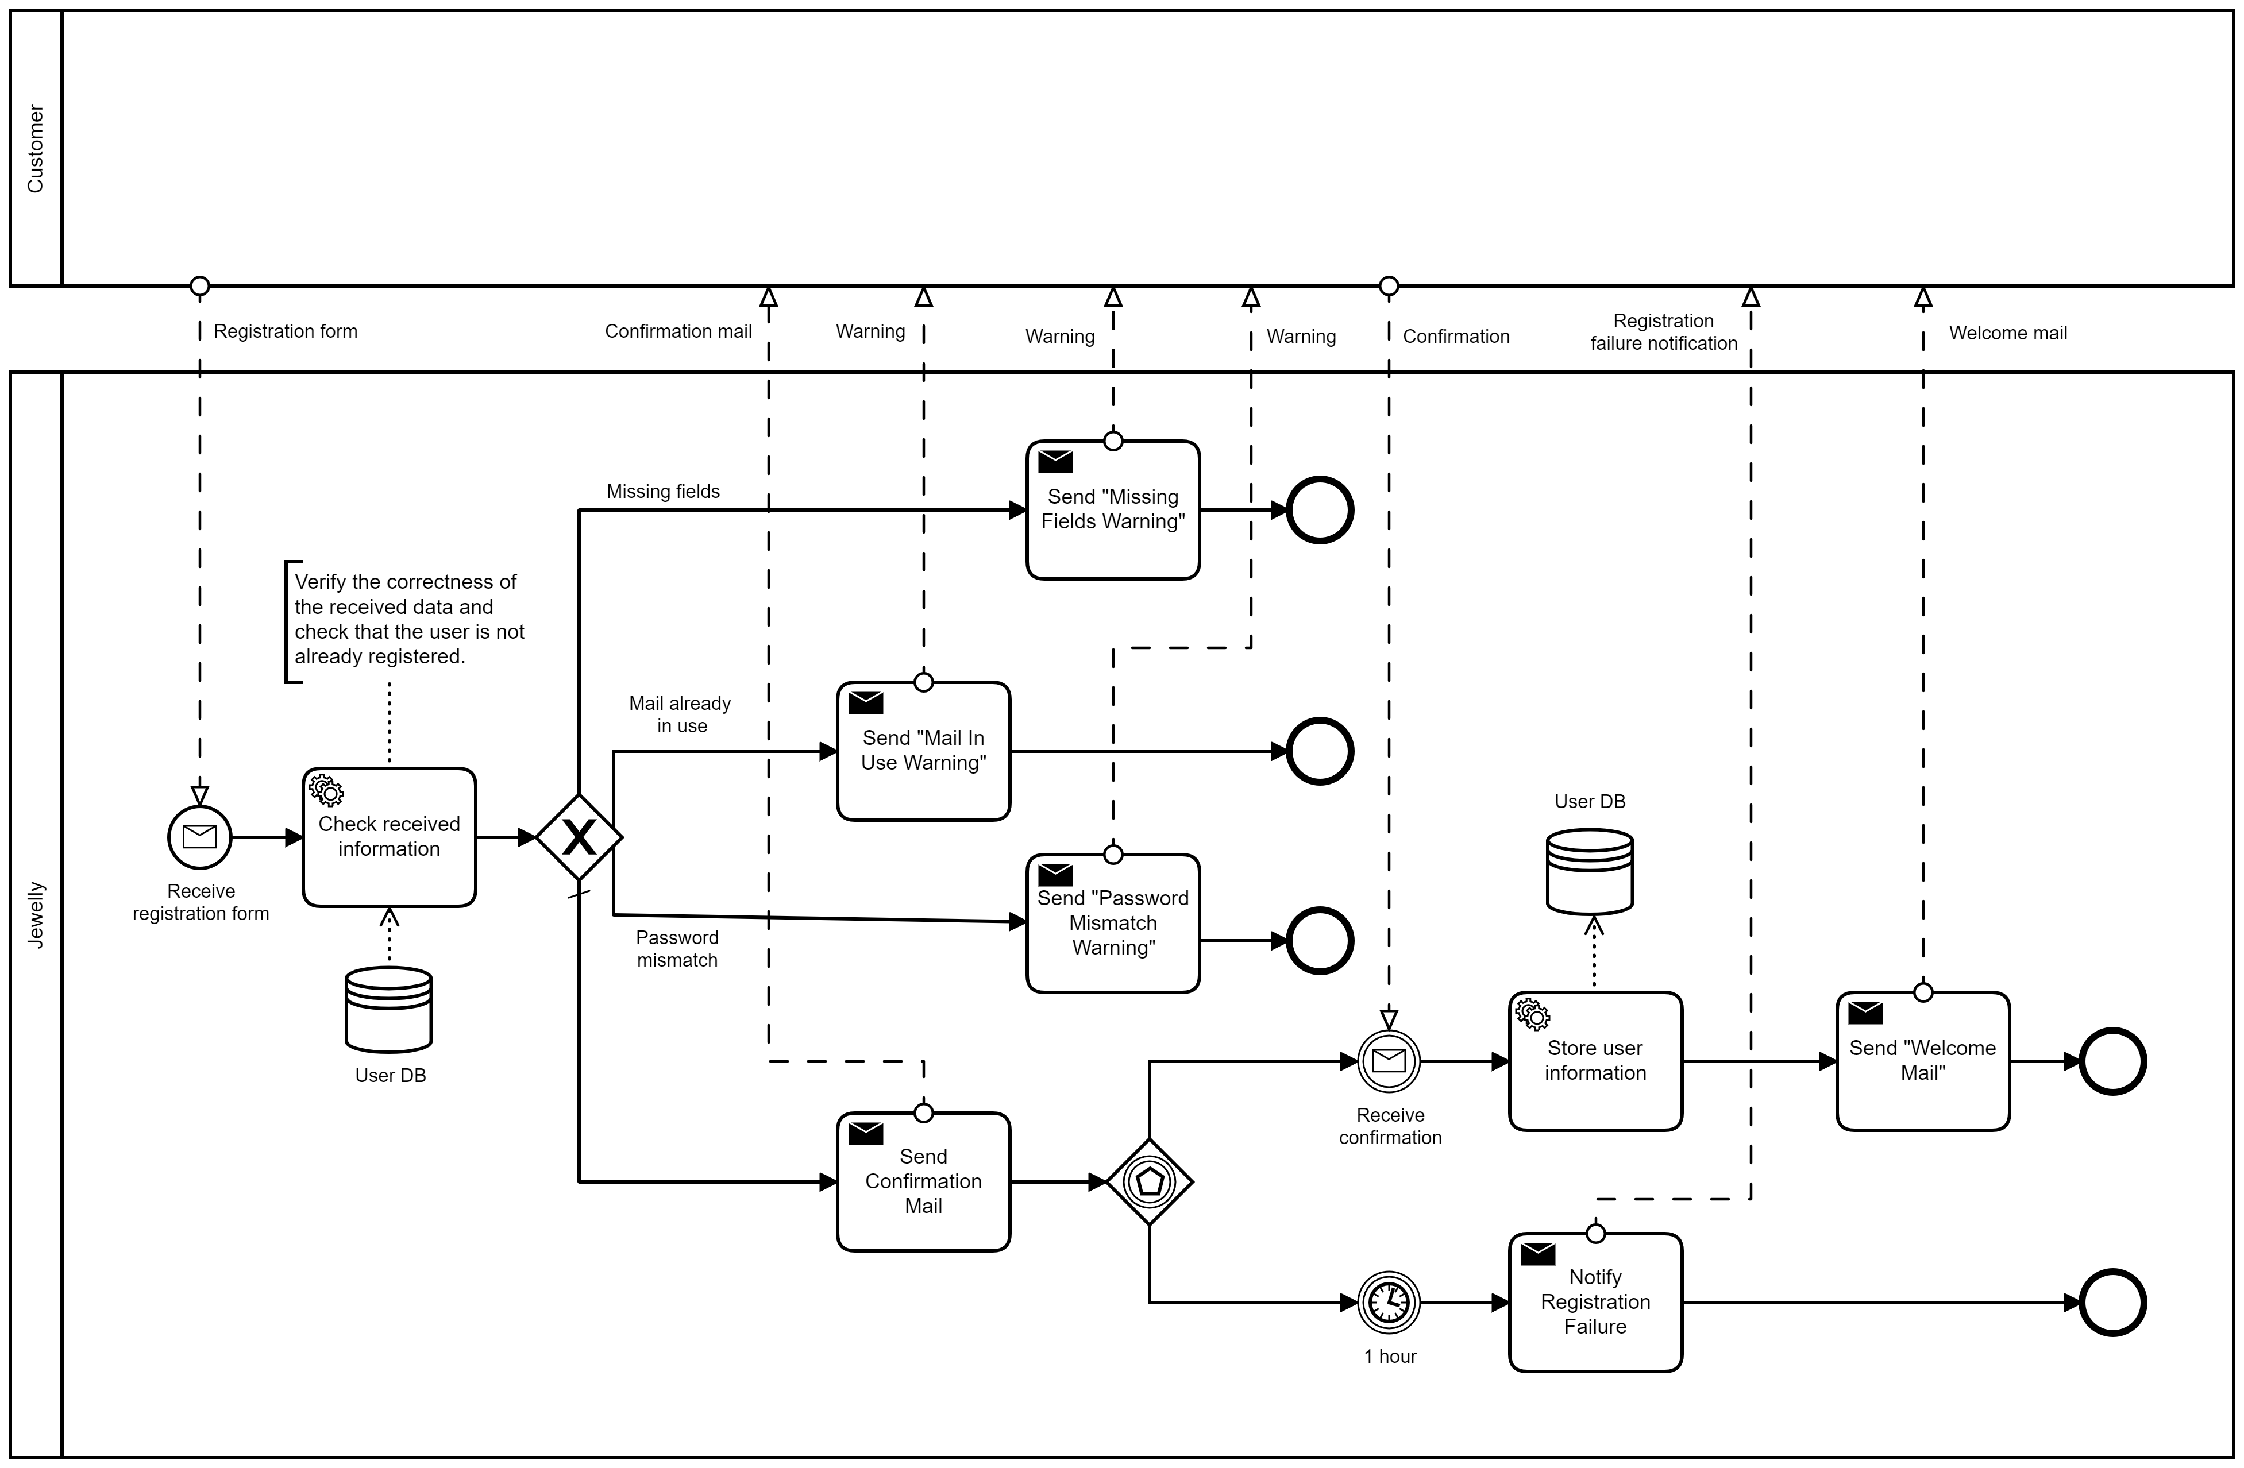
ORCHESTRATION
USER REGISTrAtioN
During the registration we control of the correctness of the data.
The database is used both to verify the customer data and to memorize them when the registration is confirmed.

Slide 19
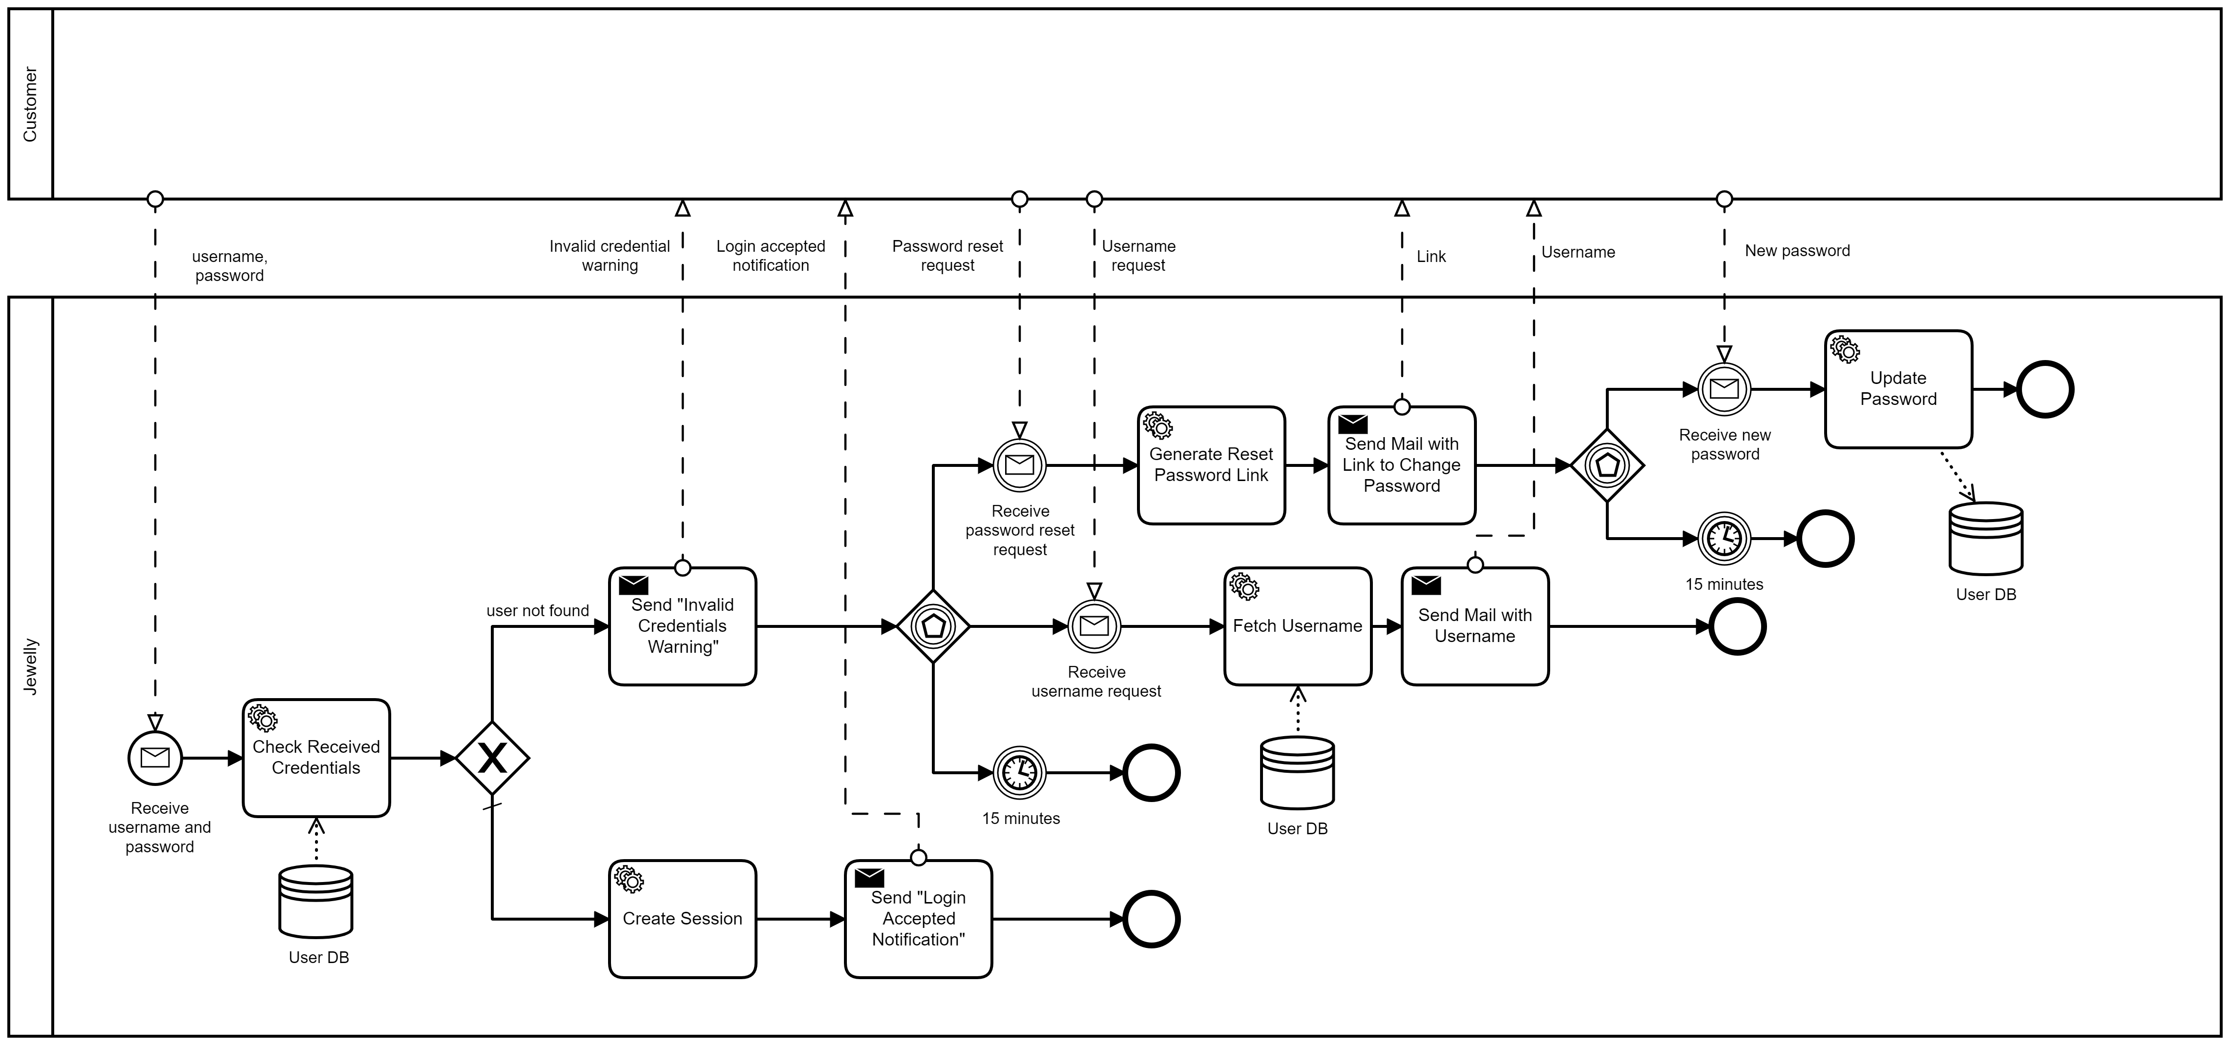
ORCHESTRATION
USER LOGIN

Slide 20
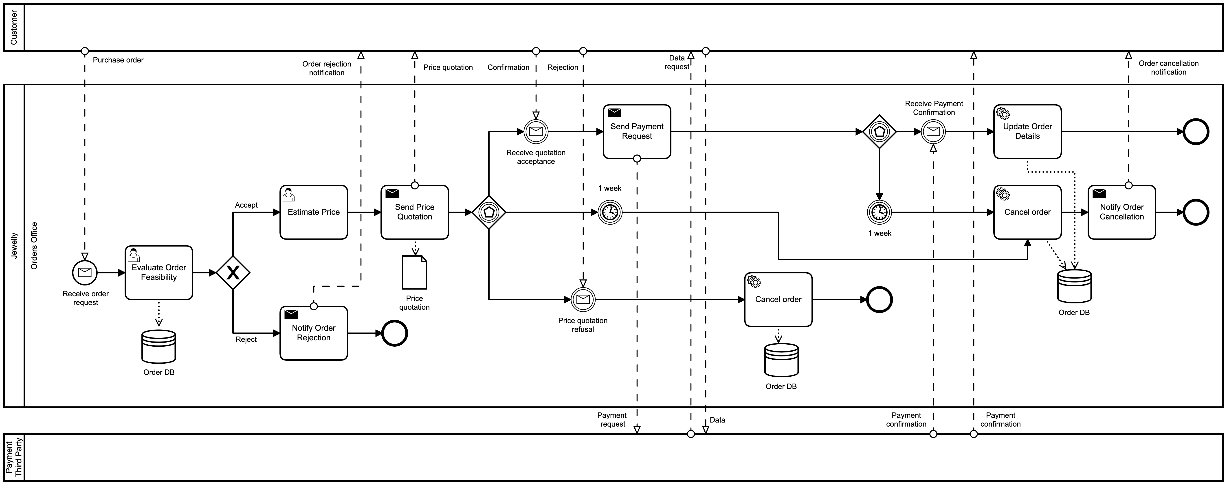
ORCHESTRATION
RECEIVE ORDER

Slide 21
ORCHESTRATION
FULFILL ORDER
PART I
A service task, verify the availability of raw materials.
If the resources are not in stock, the company has to purchase materials before proceeding with the production.
Once the company has received the materials, or if the resources are already in stock, a set of user tasks, concerning the production, are executed.

Slide 22
ORCHESTRATION
FULFILL ORDER
PART ii
After the production, the company sends a request for delivery to a third-party service.
After the package has been delivered, in addition to the update of the status, the delivery partner billing, that will be useful when the delivery partner will be paid, is saved on a dedicated database.
During the delivery process, an exception can generates: the loss of the package. In that case, the user is reimbursed.

Slide 23
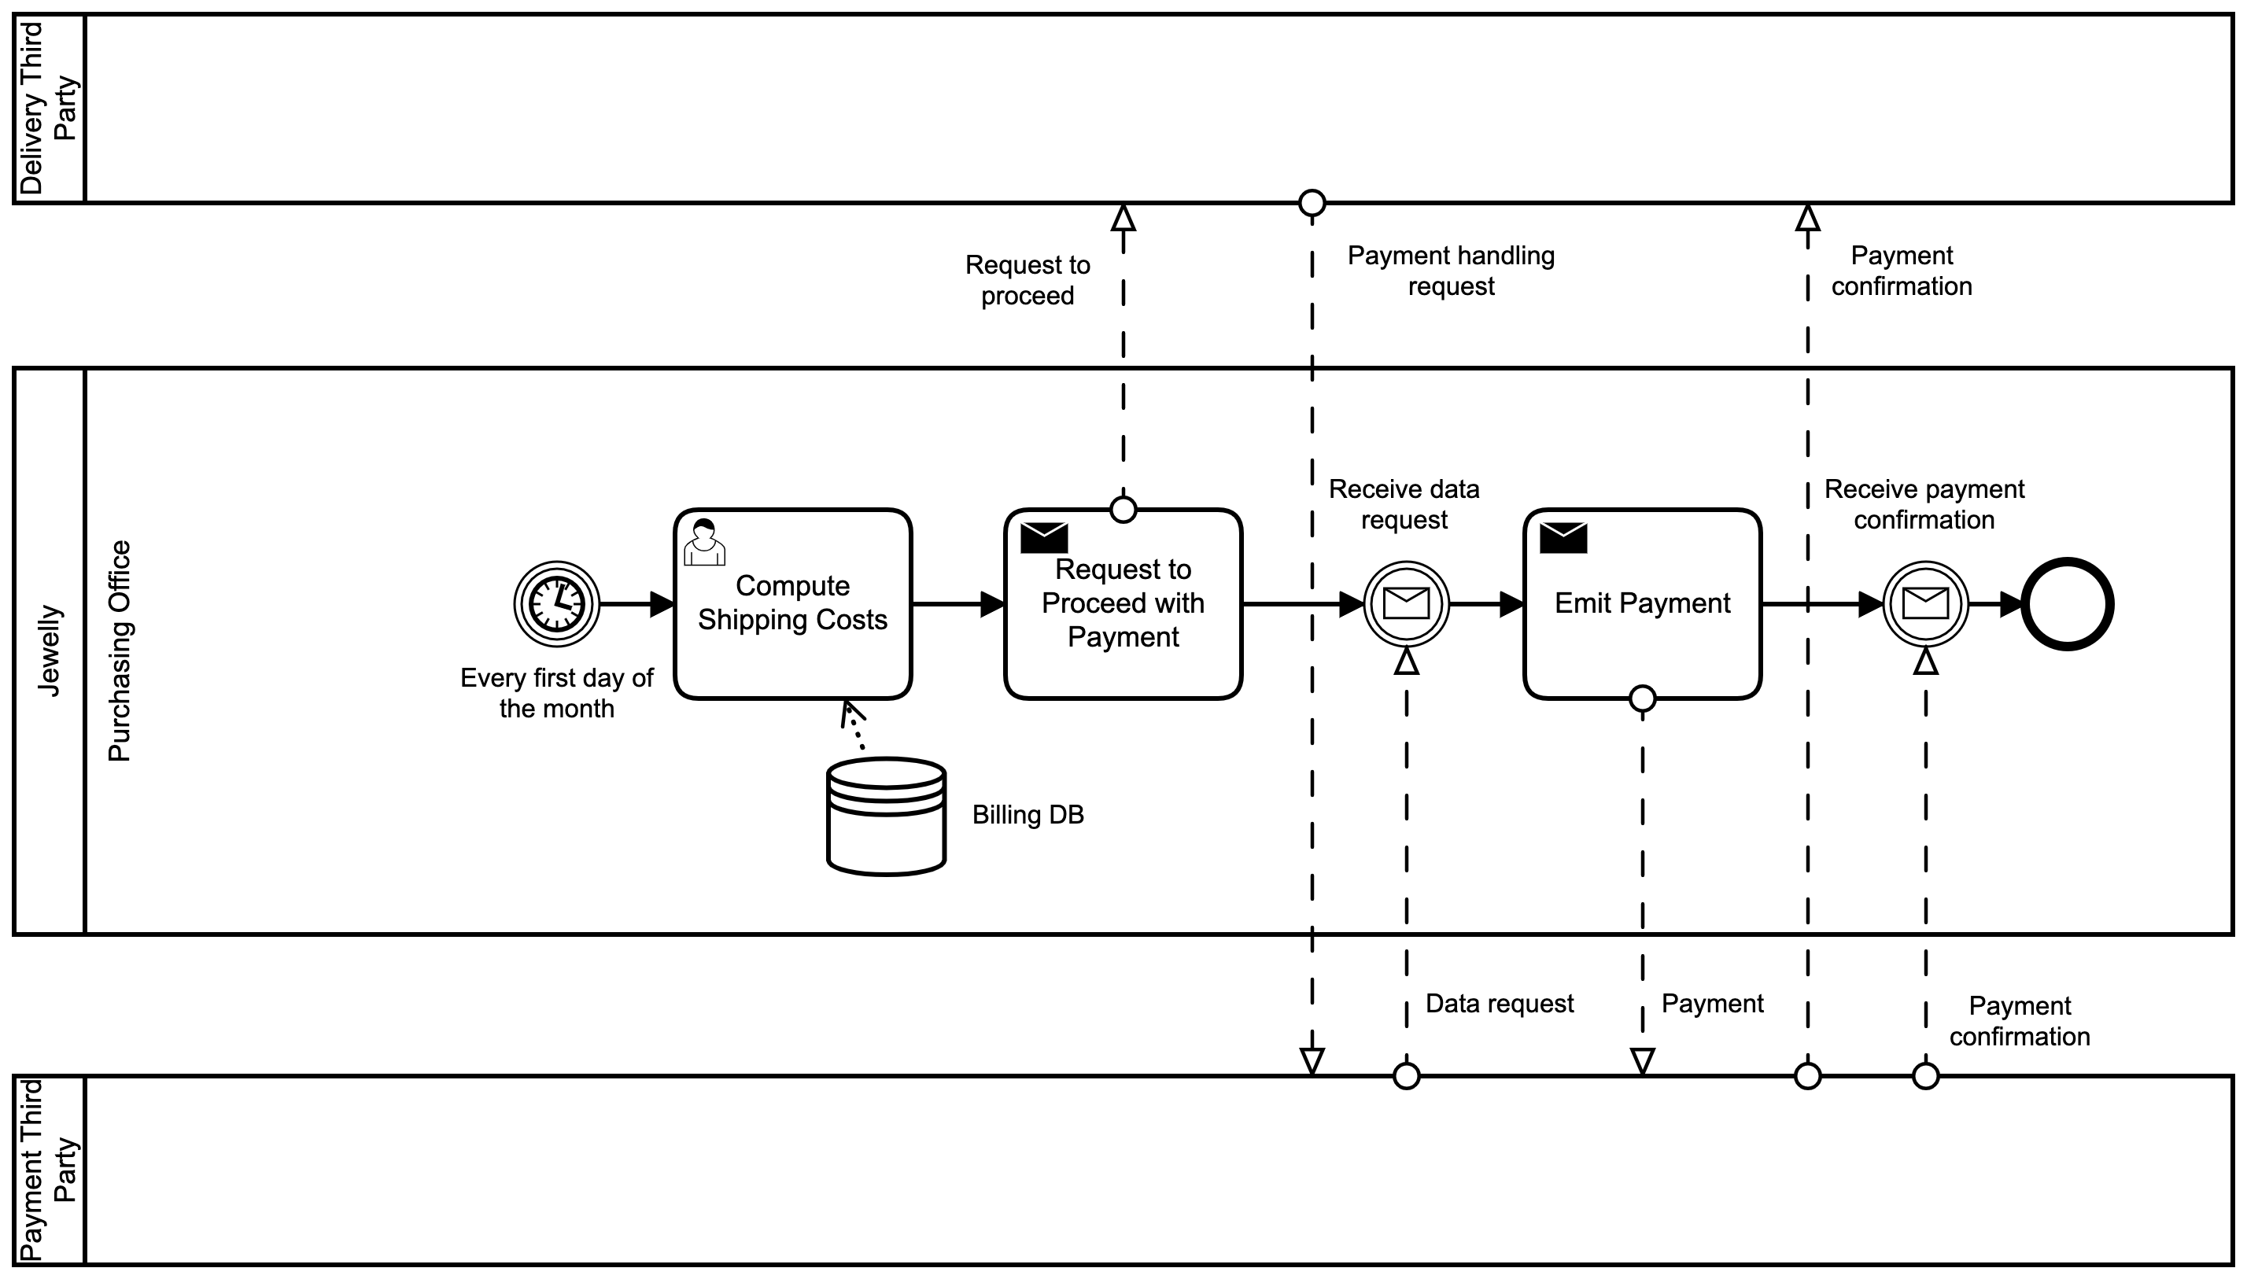
ORCHESTRATION
FULFILL ORDER
PART IIi
Every first day of the month our company pays the delivery partner.
The shipping cost is computed through the data saved in the billing database

Slide 24
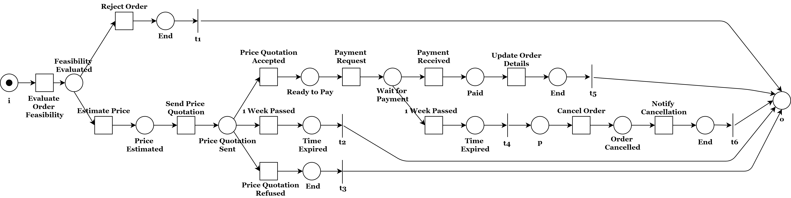
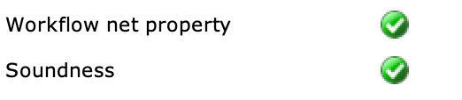
SOUNDNESS
RECEIVE ORDER
The soundness is a property that allow to identify correct WF-nets and so business processes.
A WF-Net (corresponding to a BP) is sound if and only if: for any case, the procedure will terminate eventually, and at the moment the procedure terminates there is a token in place ‘o’ (the final place) and all the other places are empty.

Slide 25
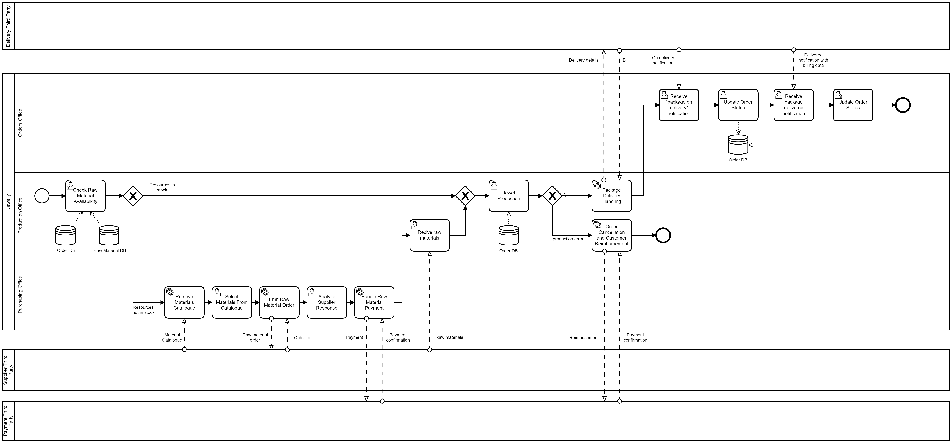
IMPLEMENTATION
SIMPLIFIED FULFILL ORDER

Slide 26
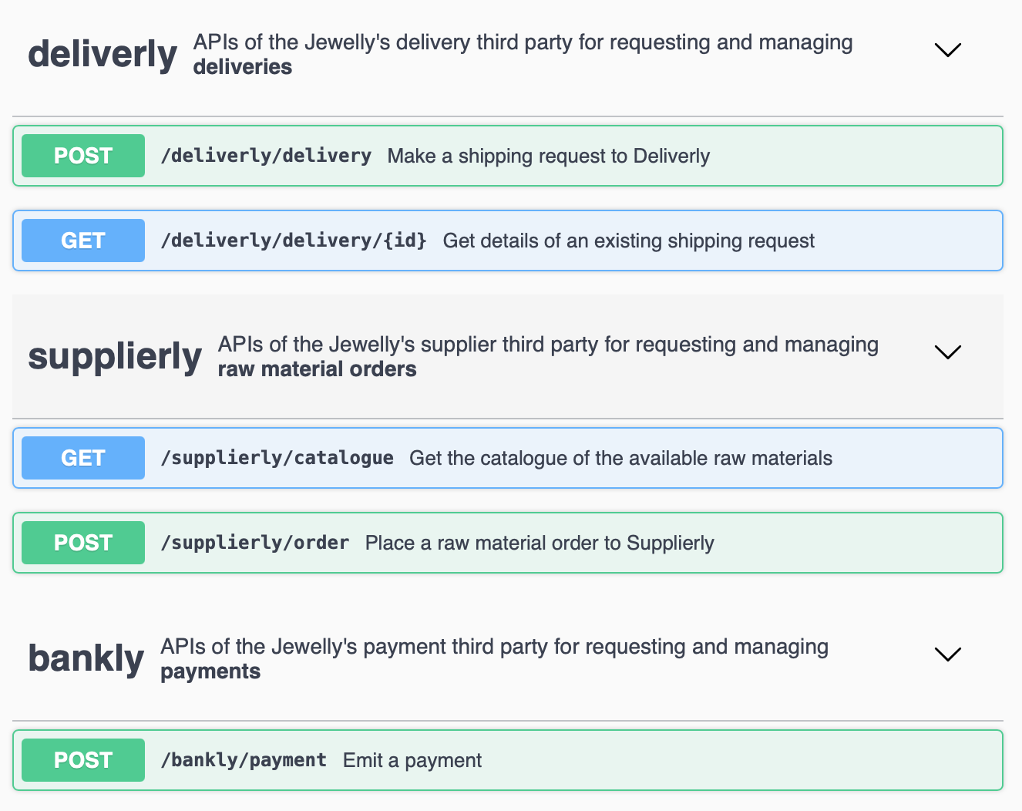
REST API
We have three external services:
Deliverly: for requesting and managing deliveries.
Supplierly: for requesting and managing raw materials orders.
Bankly: for requesting and managing payments.

Slide 27
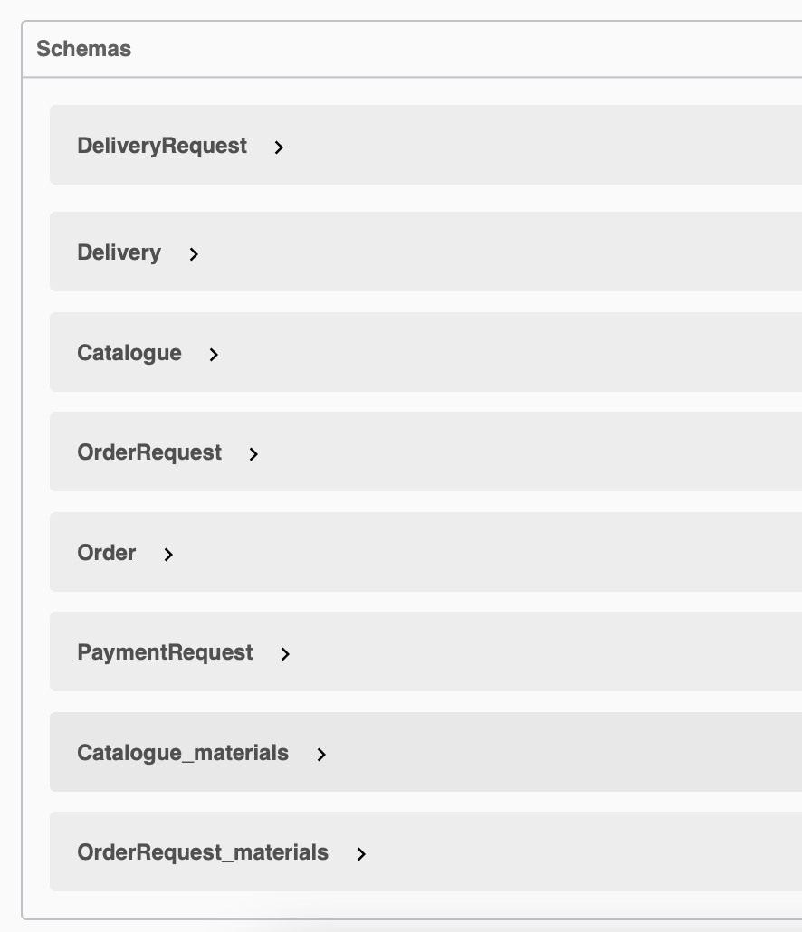
REST API
SCHEMAS
The majority of the exchanged messages are structured according to some schemas that we have defined.

Slide 28
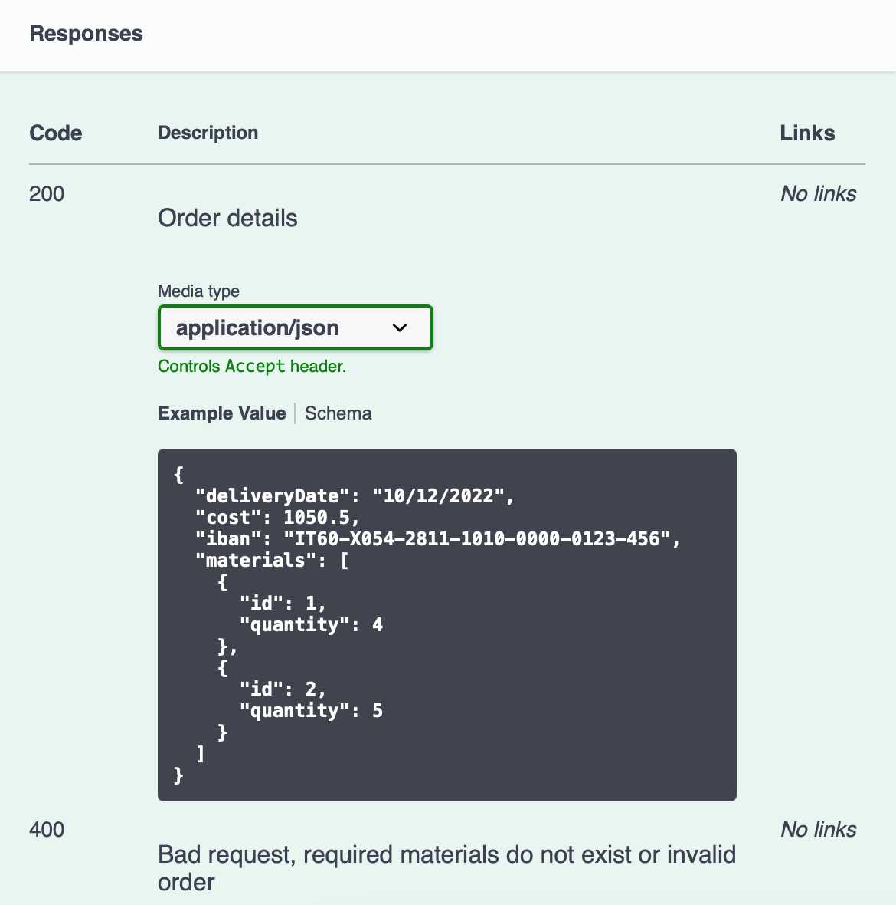
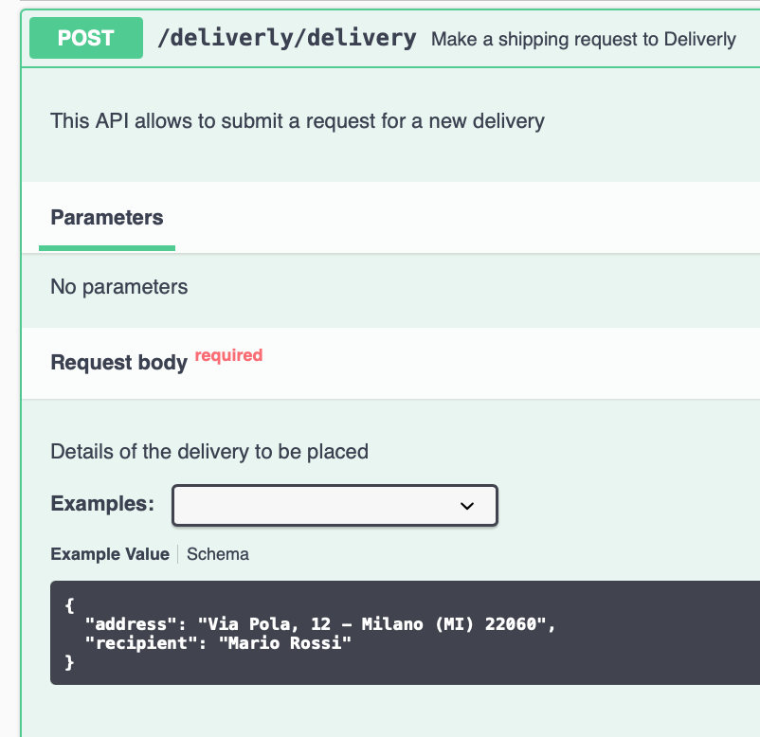
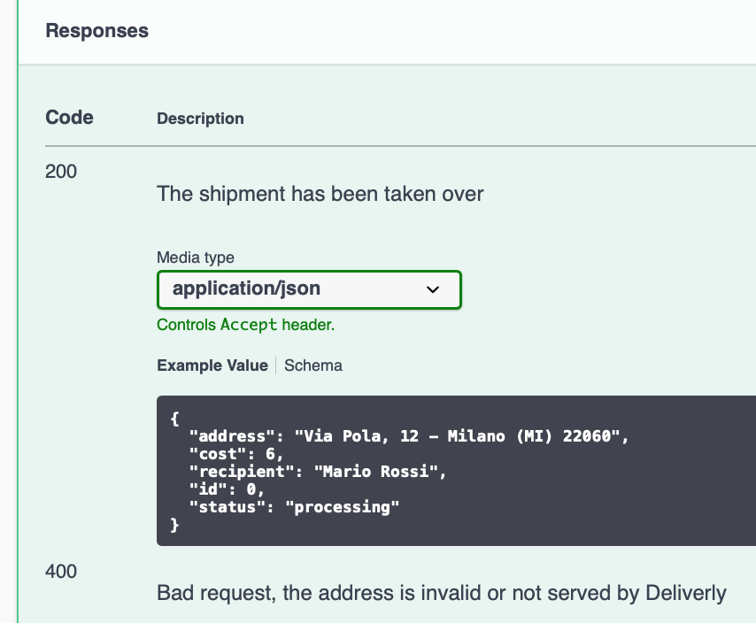
REST API
DELIVERY PARTNER

Slide 29
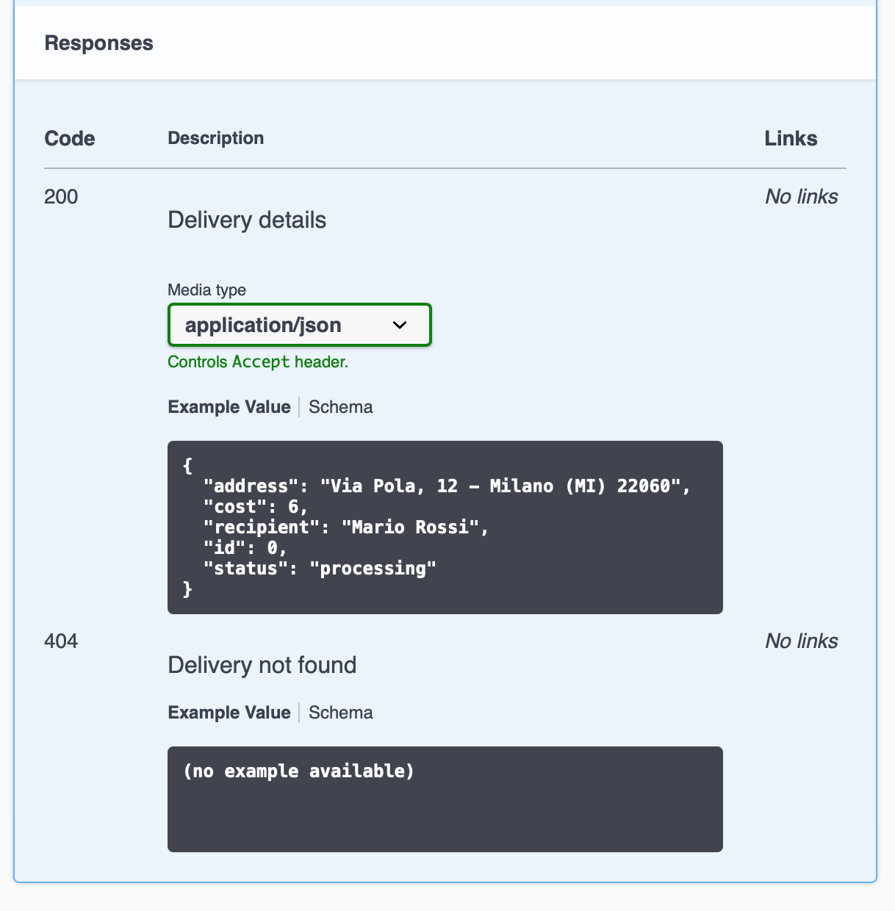
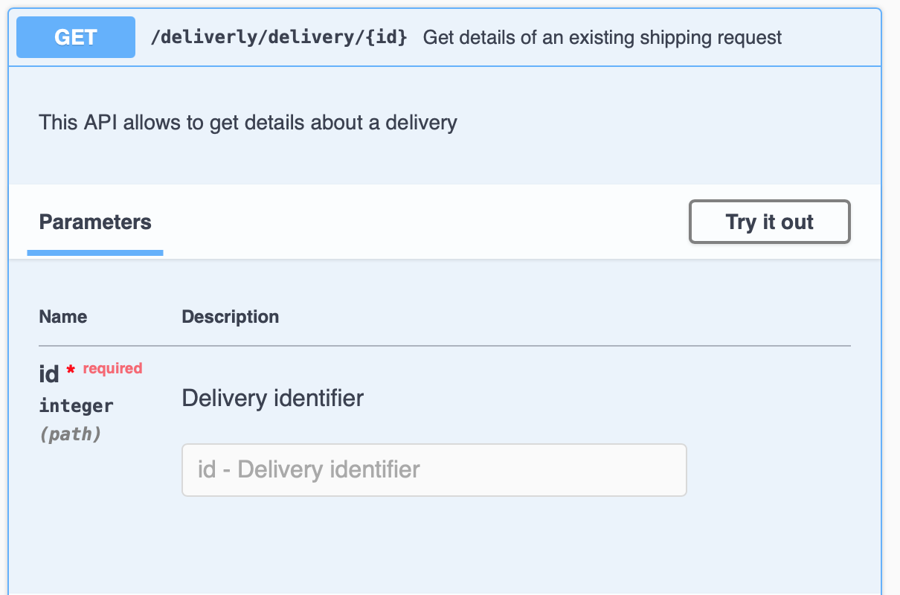
REST API
DELIVERY PARTNER

Slide 30
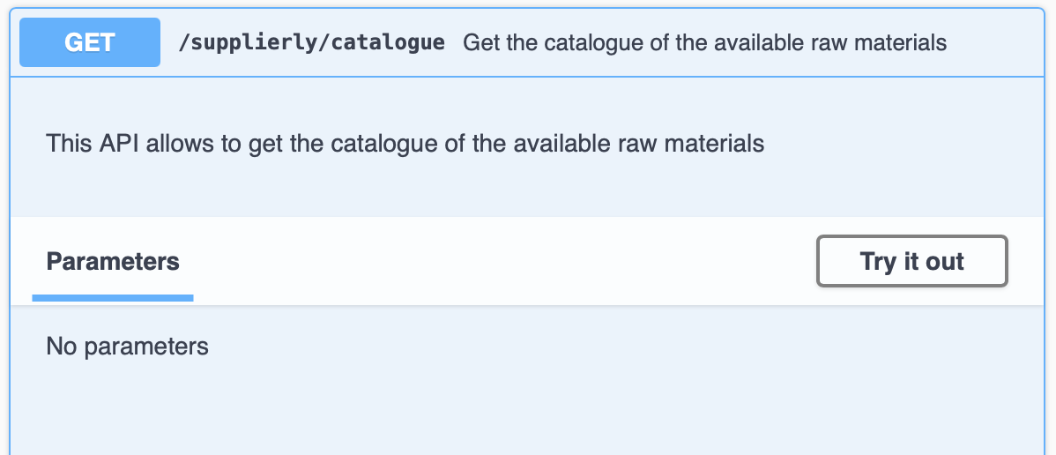
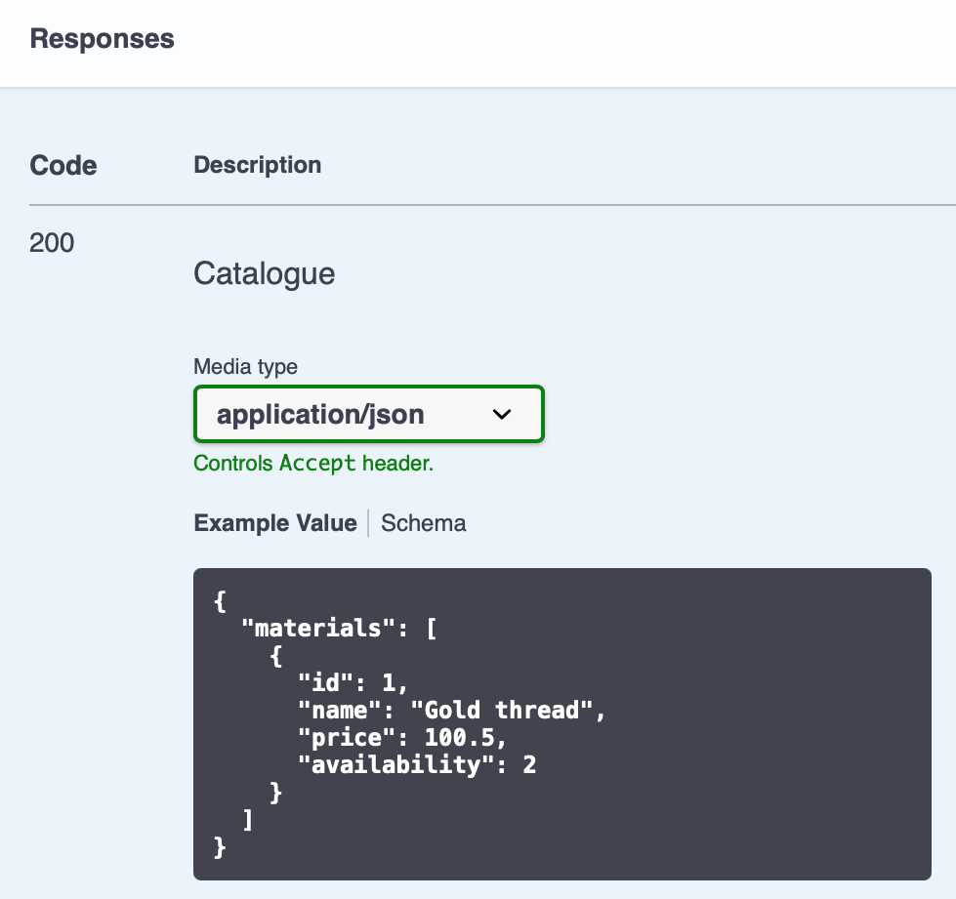
REST API
SUPPLY PARTNER

Slide 31
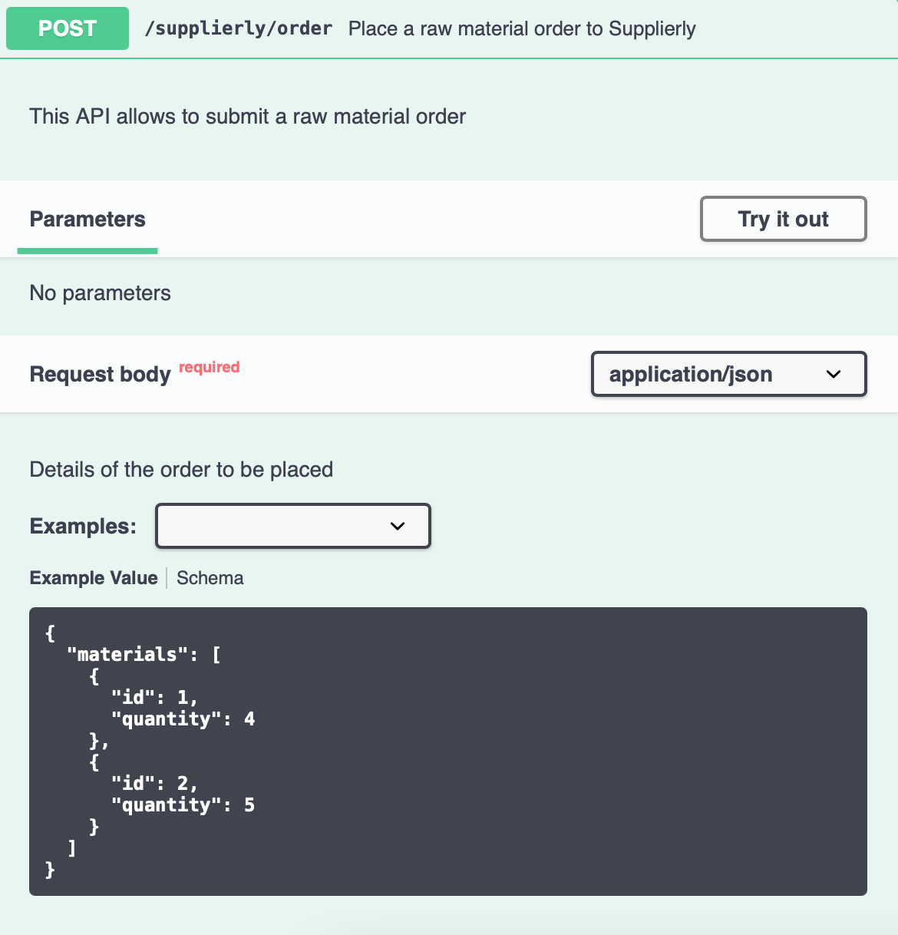
REST API
SUPPLY PARTNER

Slide 32
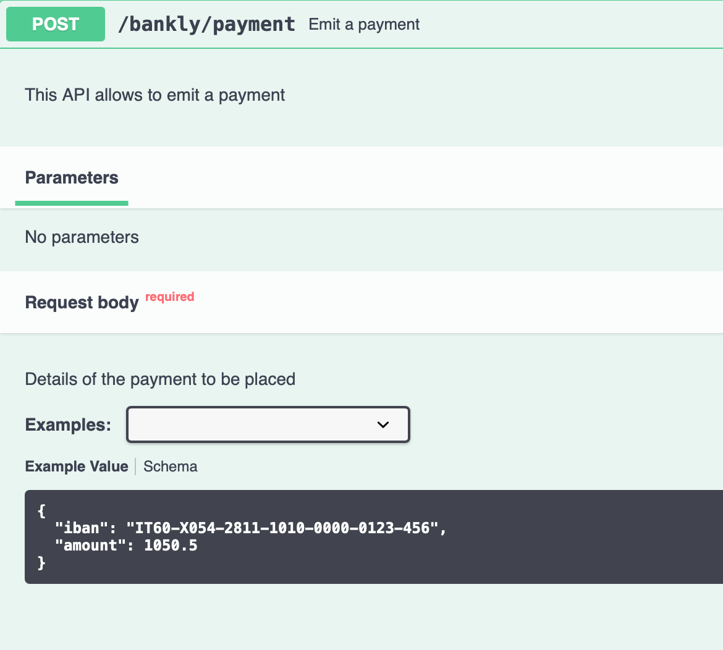
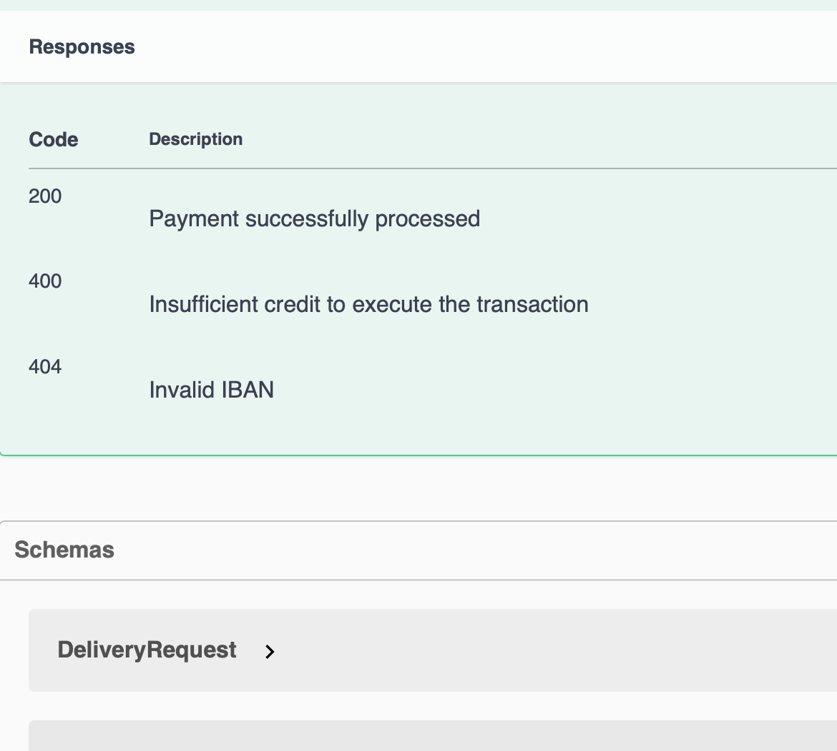
REST API
PAYMENT PARTNER

Slide 33
20th july 2021

